Slide 1
Welcome and Overview
Tsu-Jae King Liu
Vice Provost, Academic and Space Planning
March 2017

Slide 2

UC Berkeley today:
Best Global Universities
US News & World Report (2017)
Harvard
MIT
Stanford/Berkeley
Number of Top 5 ranked Depts
National Research Council Survey of Graduate Programs (2010)
1. Berkeley: 43
2. Harvard: 40
3. Stanford: 30
Fall 2015 numbers:
Total Enrollment: 40,173 (27% Graduate)
Faculty FTE: 1865

Slide 3

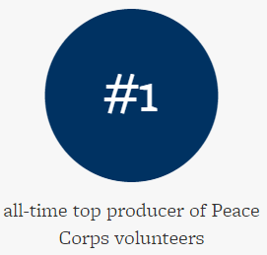
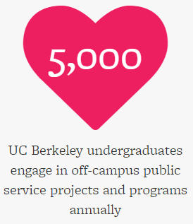
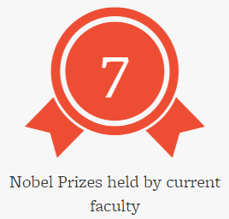
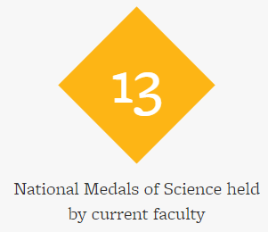
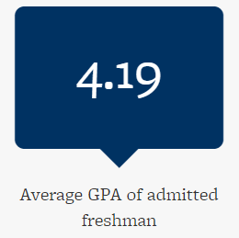
A Tradition of Excellence…
http://www.berkeley.edu/about/bythenumbers

Slide 4
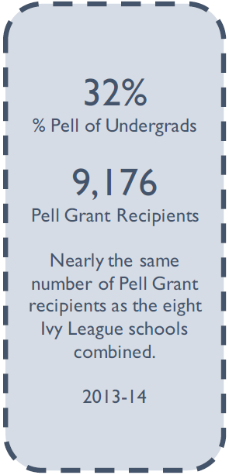
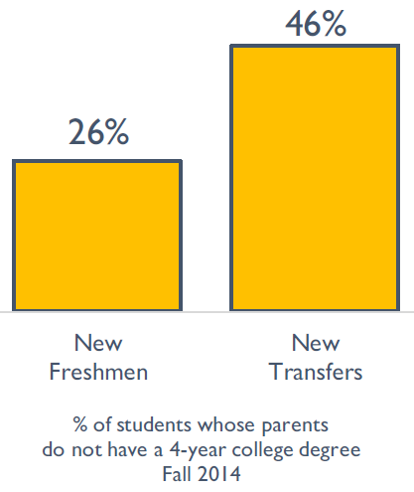
…and Access
http://www.berkeley.edu/about/bythenumbers

Slide 5
Innovation and Entrepreneurship
UC Berkeley has a legacy of innovation resulting in new products, companies and industries.
Notes:
Benefits to students:
global context (shape their perspective on critical global issues)
personal growth (develop key skills such as adaptability, independence, languages, cultural competence)
expanded career opportunities (academic and professional)

Slide 6
Global Engagement Strategy
Goals/Objectives
  Give faculty & students access to world-class experiences and resources not available at Berkeley
    Global perspective, personal development, expanded opportunities
  Bring new resources to Berkeley to bolster its mission in education, research, and service
Criteria for International Partnerships
  Alignment with Berkeley traditions of excellence & access
  Faculty interest & uniqueness of value proposition
  Adequate resources (seed funding, space) at Berkeley
Notes:
Benefits to students:
global context (shape their perspective on critical global issues)
personal growth (develop key skills such as adaptability, independence, languages, cultural competence)
expanded career opportunities (academic and professional)

Slide 7
Global Engagement Office
Mission:
  Support and facilitate UC Berkeley’s global strategy
Activities:
  Host international delegations and connect visitors to appropriate UC Berkeley staff and faculty
  Provide templates, liaise between departments, and review agreements for new partnerships
  Maintain database on UC Berkeley’s global activity (agreements, delegation visits, research collaborations)
  Advise units on best practices for global engagement
  Identify potential partnerships and evaluate existing ones

Slide 8
International Partnerships
Can be at the faculty, departmental, college/school, or campus level
Require a strong foundation of mutually beneficial faculty collaborations
  Shared values and research interests are key to success

Slide 9
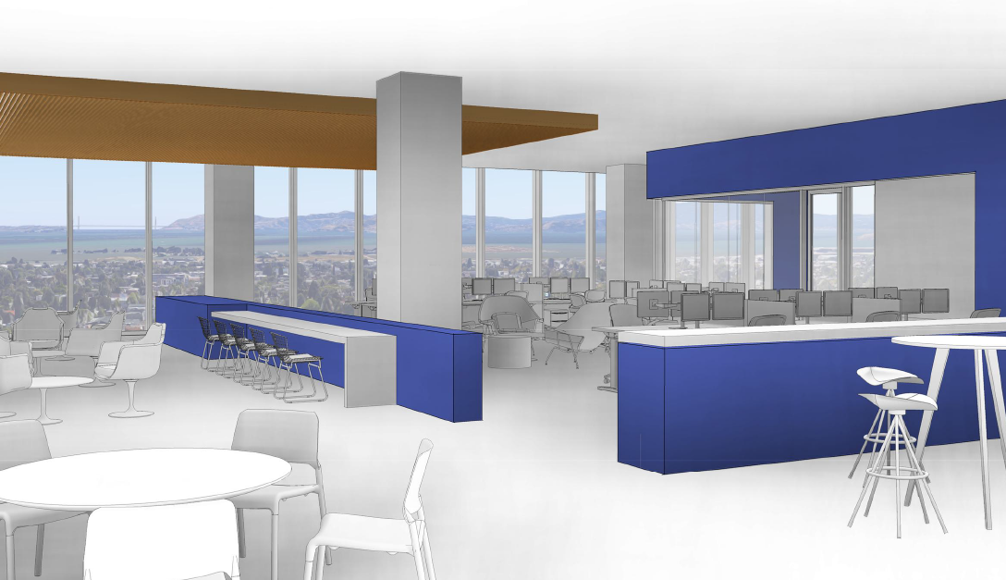
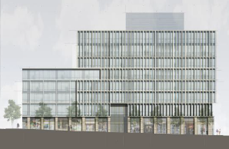
Faculty Collaborations
Can be cultivated through
  Theme-based workshops
  Seed funding for collaborative projects
→ Space for incubating/accelerating new partnerships
  Meeting rooms (w/ videoconferencing)
  Offices
  Collaboratory and
  maker spaces
Berkeley Way West Bldg.
Notes:
Details of lease opportunity in the new Berkeley Way West building:
Rent for UC Berkeley community members/units is $3.50/rsf/month with 3% annual rent increases. Considering that the average lease is >$5.75/sf for commercial space in downtown Oakland, I think we should charge $5/sqft to non-Berkeley tenants, with no annual rent increases. This would cover utilities, janitorial services, normal repairs and maintenance for the building.
Only 5- or 10-year lease terms are available.
Minimum space commitment is 5,000 rsf. The costs of space planning services (to determine space requirements, develop layouts and any construction plans) must be covered by the department or unit.
A tenant improvement (TI) allowance of $75.00 per rentable square foot will be provided by the project. (The space will be delivered as a cold shell, and tenants will need to cover the costs of building out their leased space to meet programmatic needs.) In other words, TI costs beyond $75/rsf must be covered by the tenant. The estimated TI cost is in the range $135-185/rsf, depending on the type of improvements needed.

Slide 10
Partnering with UC Berkeley
With sufficient faculty interest and commitment, a Memorandum of Understanding may be established
  Non-binding statement of interest to collaborate
  Facilitates exchange of scholars and student researchers, sharing of academic, teaching and research materials
  Basis for more detailed agreements in the future
GEO facilitates MOUs by
  Providing templates and review
  Tracking, evaluating and renew agreements as needed

Slide 11
Partnership Development
Specific and formal agreements
  What are the shared research interests?
  What unique resources or opportunities does each party bring to the collaboration?
  Are there sufficient resources (faculty and staff time; space, facilities, and equipment; funding) to support the partnership?
Typically facilitated by the departments involved, GEO, and/or the Sponsored Projects Office

Slide 12
Berkeley Global Initiative
Large (multi-disciplinary) Strategic Partnerships coordinated at the campus level
  Centered around topics of mutual interest to faculty at Berkeley and at one or more international universities
  Built upon a strong foundation of existing collaborations, with many faculty-to-faculty interactions and exchanges in research and teaching

Slide 13
Summary
UC Berkeley stands out for its commitment to academic excellence, access, and public service.
  A culture of openness, freedom, and acceptance − academically, artistically, politically, and culturally.
We welcome all who share our values and passion for discovery and innovation to join in our mission
  Educate future leaders
  Create new knowledge
  Serve society

