Slide 1
Preparing for Academic Program Review (APR)
Division of Academic and Space Planning
January 18, 2018
Notes:
Preparing for Academic Program Review
​This session of the 2017-18 New Chairs Program will cover the academic program review process and best practices for departmental strategic planning. Vice Provost for Academic and Space Planning Tsu-Jae King Liu will describe the academic program review process, which gives the Department the opportunity to perform a comprehensive self-assessment to identify strengths and weaknesses and to strategically plan its future. Organizational Consultant Katherine Mitchell will discuss how to engage your department in a successful ​strategic planning process which leverages innovative thinking and consensus building. Additionally, advice for developing a diversity plan will be provided by Amy Scharf, Director of Diversity Initiatives, Division of Equity and Inclusion, and advice on curriculum assessment will be provided by Yuki Watanabe, Senior Consultant Assessment & Evaluation at the Center for Teaching and Learning.
​Presenters
Tsu-Jae King Liu, Vice Provost, Academic and Space Planning
​Katherine Mitchell, Organizational Consultant, Human Resources
Amy Scharf, Director of Faculty and Diversity Initiatives, Equity and Inclusion
Yuki Watanabe, Senior Consultant Assessment & Evaluation, Center for Teaching and Learning

Slide 2
Objectives
Shared understanding of APR function
  “Why is APR important?”
  “How will APR benefit my academic unit?”
Familiarity with APR support team & services
Advice for a successful review

Slide 3
Introductions
Please share with us:
Your name and academic unit
One thing you would like to learn today?

Slide 4
Agenda
Time | Topic | Lead Presenter
9:15 a.m. | Overview of APR process | Tsu-Jae Liu
10:00 a.m. | Strategic planning | Katherine Mitchell
10:15 a.m. | Equity & inclusion planning | Amy Scharf
10:30 a.m. | Curriculum assessment | Yukiko Watanabe
10:45 a.m. | Additional Q&A

Slide 5
APR Purpose and Function
Comprehensive assessment to identify strengths and areas for improvement
  research focus
  opportunities and challenges
  programmatic evaluation of student learning
  assessment of resources
Plan for the future
  academic unit strategic planning
  equity and inclusion planning
Essential for Berkeley’s institutional accreditation by WASC Senior College and University Commission (WSCUC)

Slide 6
APR Benefits
Self assessment and strategic planning
  Assistance from APR Support Team
Advice from external peers
  External Review Committee (ERC)
Feedback from administrative leaders and Academic Senate committees
  Recognition of department’s strengths and needs

Slide 7
APR Support Team
Anya Grant, APR Coordinator
Katherine Mitchell, Organizational Consultant
Amy Scharf, Equity and Inclusion Consultant
Yuki Watanabe, Outcomes Assessment Consultant
Malcolm Quon, Institutional Research Analyst
John Scroggs,
  Chief of Staff, Academic & Space Planning

Slide 8
A Testimonial
“I want to thank you and your staff for all your assistance in what was (in retrospect now!) a very useful and productive process. We were able to make excellent use of this report/data with our external advisory board and this week during our ABET review and it will be very helpful in our building out our future plans.”
− David Dornfeld, Chair, Department of Mechanical Engineering

Slide 9
Preparing for the Review
1 year before the ERC site visit:
  Kick-off meeting with the Vice Provost
  Meeting with APR Support Team
  Submission of names of candidates for the ERC
  Submission of names of candidates for Senate Liaison
  Commence self-study report
2 months before ERC site visit:
  Submission of self-study report
  Finalize ERC meeting agenda in consultation with the APR Coordinator

Slide 10
Outline of Self Study Report
(recommended 40 pages or less)
Executive Summary
Current State of the Unit
Draft Strategic Plan
  Vision and strategic priorities
  Research (intellectual focus)
  Education (objectives, learning goals, assessment)
  Faculty Strategic Hiring Plan
  Resources (staff, facilities & infrastructure, finances, governance & administration)
Equity and Inclusion Plan
Appendix: Faculty biosketches

Slide 11
Online Resources
Academic repository
  Babette Schmitt (babette@berkeley.edu)
Academic planning dashboard
  Malcolm Quon (malcolm@berkeley.edu)

Slide 12
Review Process
ERC Site Visit:
  1 or 1.5 days with the academic unit
  Program Review Oversight Committee (PROC) debriefing
  Submission of ERC and Senate Liaison reports
Academic unit response to reports
Academic Senate reports
PROC wrap-up meeting
Outcome letter (~6 months after ERC site visit)
Mid-cycle check-in

Slide 13
Tips for a Successful Review
Heed guidelines and deadlines
  Don’t procrastinate!
Engage your faculty early and often
Be concise in writing your unit’s self-study
Engage the APR support team staff as often as you need – we’re here to help!

Slide 14
Mid-Cycle Check-In
Purpose:
  Ensure that issues are adequately addressed
  Update administrative leadership on new challenges and/or opportunities
Mid-Cycle Check-In Form

Slide 15
Agenda
Time | Topic | Lead Presenter
9:15 a.m. | Overview of APR process | Tsu-Jae Liu
10:00 a.m. | Strategic planning | Katherine Mitchell
10:15 a.m. | Equity & inclusion planning | Amy Scharf
10:30 a.m. | Curriculum assessment | Yukiko Watanabe
10:45 a.m. | Additional Q&A

Slide 16
Defining “Strategic”

Slide 17
Defining “Strategic”

Slide 18
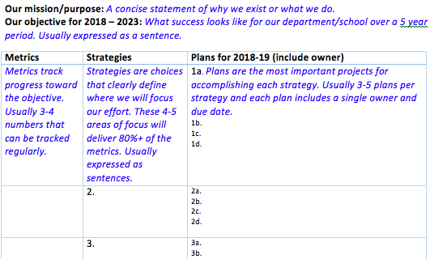
One Page Summary of Department/School Strategic Plan

Slide 19
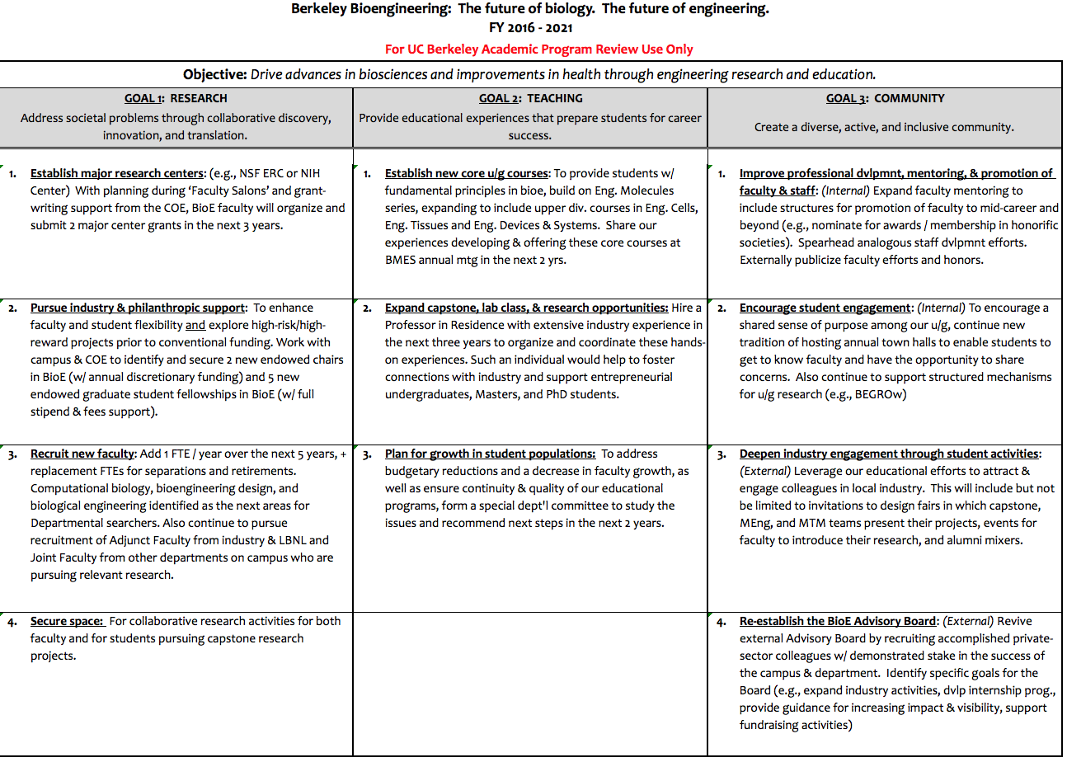

Slide 20
Agenda
Time | Topic | Lead Presenter
9:15 a.m. | Overview of APR process | Tsu-Jae Liu
10:00 a.m. | Strategic planning | Katherine Mitchell
10:15 a.m. | Equity & inclusion planning | Amy Scharf
10:30 a.m. | Curriculum assessment | Yukiko Watanabe
10:45 a.m. | Additional Q&A

Slide 21
Equity and Inclusion Planning
Campuswide initiative
  Every academic unit creates a plan
Goals
  Advance equity, inclusion and diversity in local units
  Build on strengths
  Address gaps and challenges
  Innovate and inspire!
Notes:
If your department has a plan:
Use it to move forward
Revise as needed
If not, contact E&I to get started

Slide 22
Key Areas
for E&I Plan
Leadership
and Vision
Mentoring
and Support
for
Diverse Groups
Curriculum, Teaching
and Research
Department Climate
Departmental Diversity
- Faculty
-Student
-Staff

Slide 23
E&I Plan Components
Introduction
  Importance of Equity, Inclusion and Diversity in Academic Unit
Academic Unit Self-Assessment
  Strengths, Gaps, and Needs
Goals and Strategies
  3-5 year horizon
Implementation Plan
Notes:
EXAMPLES:
Physics – Identity Matters – training and communications
Pub Health – revamp grad admissions re: Context of Achievement
PMB – Complete overhaul of faculty hiring process and grad admissions
Political Sci – explore new subfield on Race, Ethnicity and Religion in Politics
Phil – deep dive on gender in culture of department (and culture of the field)
TDPS – data re: 40% transfer students, curric designed as 4 year, how to adjust
EECS –CS Scholars – cohort program for entry level computer sci courses, special discussion section, extra support, community (60% women, 20-30% URM, many first gen college), also Kickstart

Slide 24


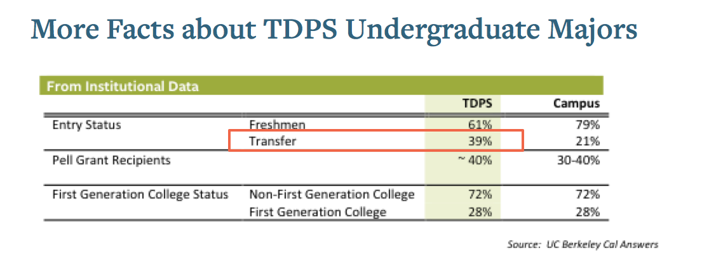
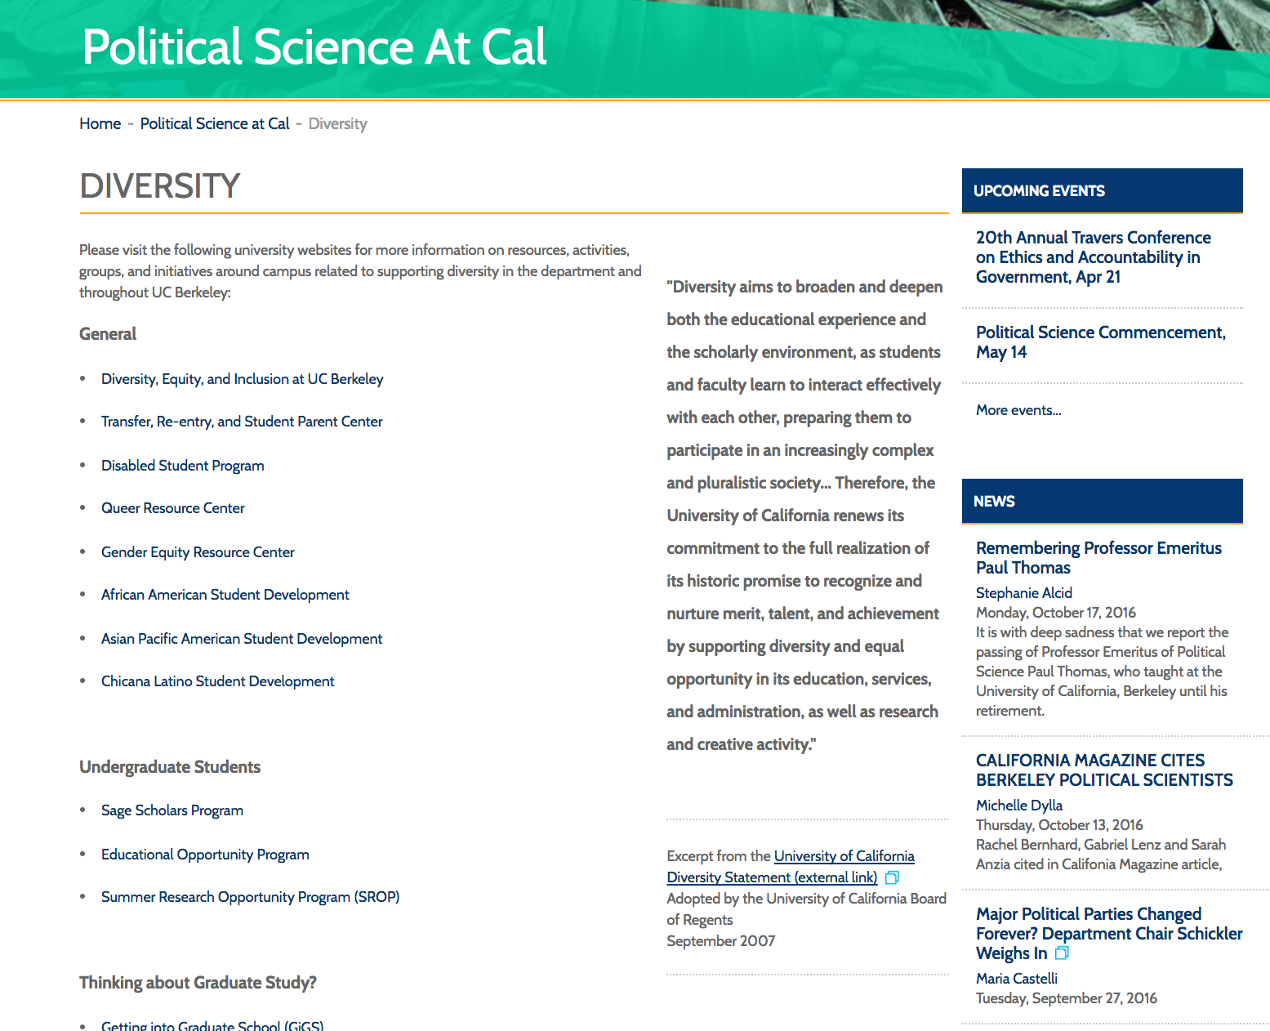
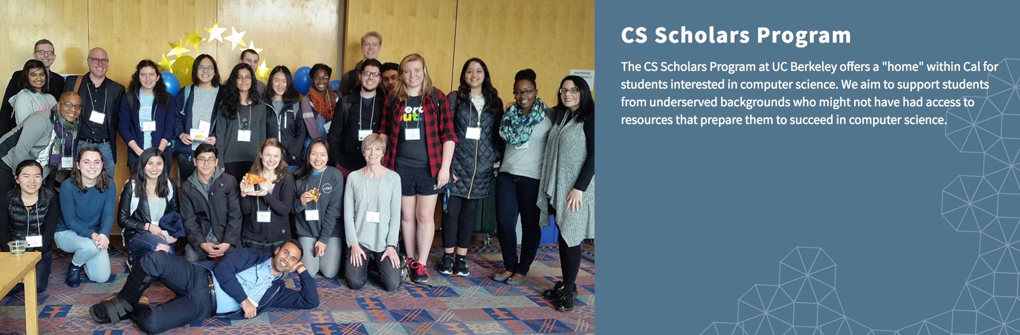
Notes:
EXAMPLES:
Physics – Identity Matters – training and communications
Pub Health – revamp grad admissions re: Context of Achievement
PMB – Complete overhaul of faculty hiring process and grad admissions
Political Sci – explore new subfield on Race, Ethnicity and Religion in Politics
Phil – deep dive on gender in culture of department (and culture of the field)
TDPS – data re: 40% transfer students, curric designed as 4 year, how to adjust
EECS –CS Scholars – cohort program for entry level computer sci courses, special discussion section, extra support, community (60% women, 20-30% URM, many first gen college), also Kickstart

Slide 25

Support and Assistance
Planning Toolkit: diversity.berkeley.edu
Sample Plans available upon request
Amy Scharf,
Division of Equity & Inclusion
Equity Advisors in other
academic units

Slide 26
Agenda
Time | Topic | Lead Presenter
9:15 a.m. | Overview of APR process | Tsu-Jae Liu
10:00 a.m. | Strategic planning | Katherine Mitchell
10:15 a.m. | Equity & inclusion planning | Amy Scharf
10:30 a.m. | Curriculum assessment | Yukiko Watanabe
10:45 a.m. | Additional Q&A

Slide 27
Curriculum Assessment
Revise/dvlp
prog-level learning outcomes
Map
curriculum
Situate
Assessment
Cycle
Use & plan
Design
Analyze
Implement

Slide 28
Email from the MCB Chair of Undergrad Affairs, Abby Dernburg
The learning objectives for our major are somewhat vague, and may also need updating.
Our learning objectives have never been mapped to specific courses.
We do not really assess how and whether students in our major meet our objectives.
We allow our course instructors to design each course as they see fit, and consequently their content sometimes overlaps, and often expects prior knowledge that may or may not have been taught in prerequisite courses. Additionally, the content of courses varies from semester to semester, depending on who is teaching them.
Our ad hoc approach to curriculum design and course development makes it difficult to identify areas of potential overlap or synergy with course offerings from other academic units.
Other faculty and students on the committee concurred that we could probably do better to develop clear learning objectives and to ensure that progression through our required courses enables MCB majors to reach those objectives. I would like to form a committee of faculty and students to try to address these issues

Slide 29


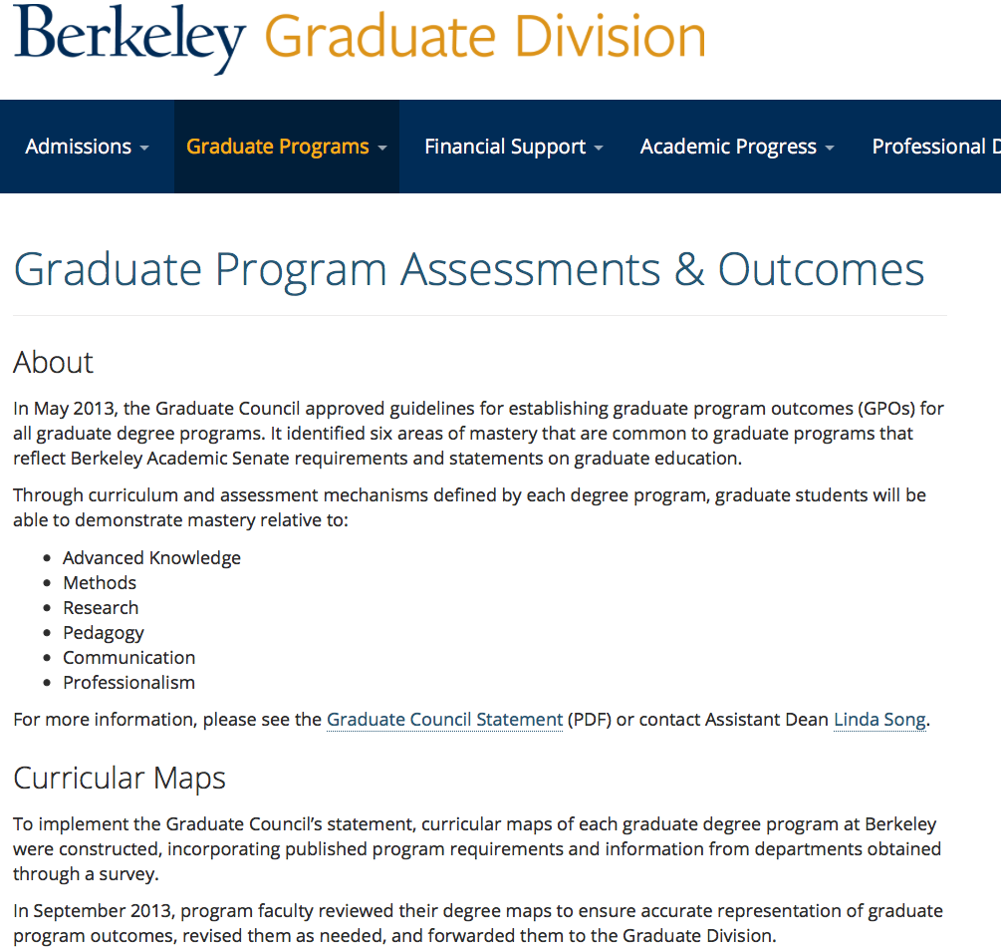
Learning Goals/Outcomes
Undergraduate
Graduate

Slide 30
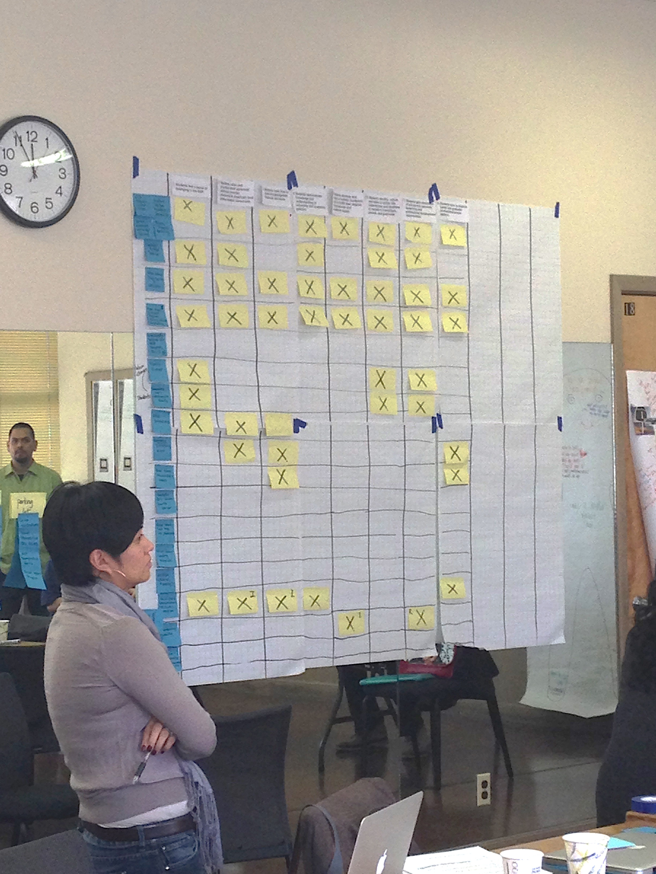
Curriculum Map
Curriculum Map
A tool to have a collective discussion on student learning opportunities across the curriculum. It is a way to analyze curricular overlaps and gaps, learn about each other’s course, and clarify the purpose of each course.
How is my course related to another course? What should I focus in my course? What can I leave out?
Are we doing too much of the same? Slim down the courses?
Do we need to add more opportunities for students to practice/refine their skills?
New course proposal: How does this fit within overall structure of the curriculum?

Slide 31
Curriculum Map
I (Introduce) → D (Develop) → M (Master)
A (Assessed): Which course has the evidence?
Where do PLOs get introduced, practiced, mastered, & assessed? | PLO1* Think like a scientist | PLO2 Lab/field skills | PLO3 Science Comm.
Senior capstone/thesis 6 | M, A | M, A | M
Pre-capstone course 5 | M |  | I
Upper-div breadth 4 | D
Upper-div requirement 3 | D | I, D, M | I
Lower-div core 2 | I, D
Lower-div breadth 1 | I
*PLO: Program-level outcomes/goals

Slide 32
WSCUC: Institutional Accreditation Requirement
Assessment rolled into Academic Program Review
For each degree program (undergrad + grad)
  Degree-level learning outcomes/goals
  Curriculum map: How courses are related to the learning goals
  Assessment: How do you know students achieved the outcomes? What resulted (were modified) based on assessment?
  System: Collectively review student learning and experience and make curricular/course/program modifications
2020 WSCUC Mid-cycle review: 2017-2019 APR cohort
2024 WSCUC Institutional review: All degree programs

Slide 33
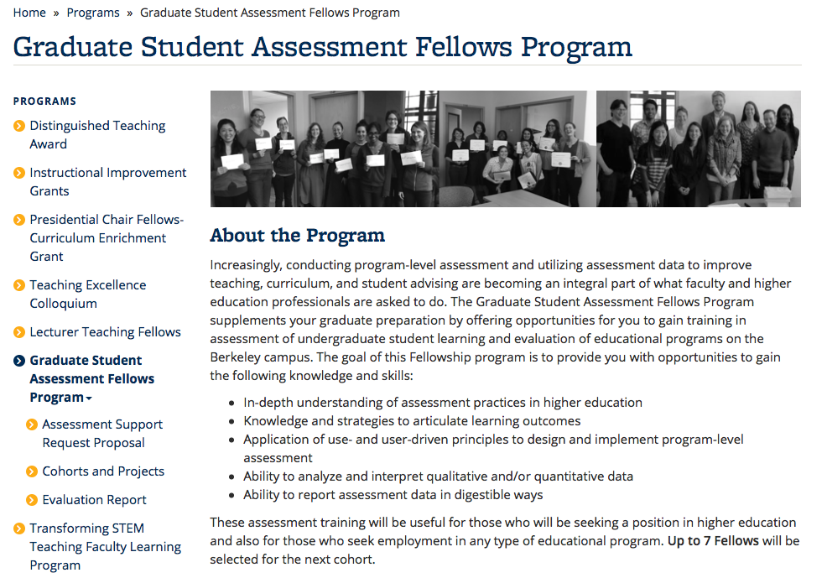
In-training graduate student, 5hrs/week during spring semester
Co-mentoring: Department & CTL
Call for assessment support request: September
Notes:
Clarify/revise program-level student learning goals by gathering input from faculty, students, and other key stakeholders.
Examine what are the common foundational knowledge and skills needed across curricular tracks to inform the revisions of the required core courses.
Understand how research skills are threaded across curriculum by analyzing syllabi and interviewing faculty and discuss what needs to be improved.
Understand the impact of a recent curricular change (e.g., a new requirement, a new pedagogical innovation made across courses) on student learning. Understand what was effective and what needs further adjustment.

Slide 34
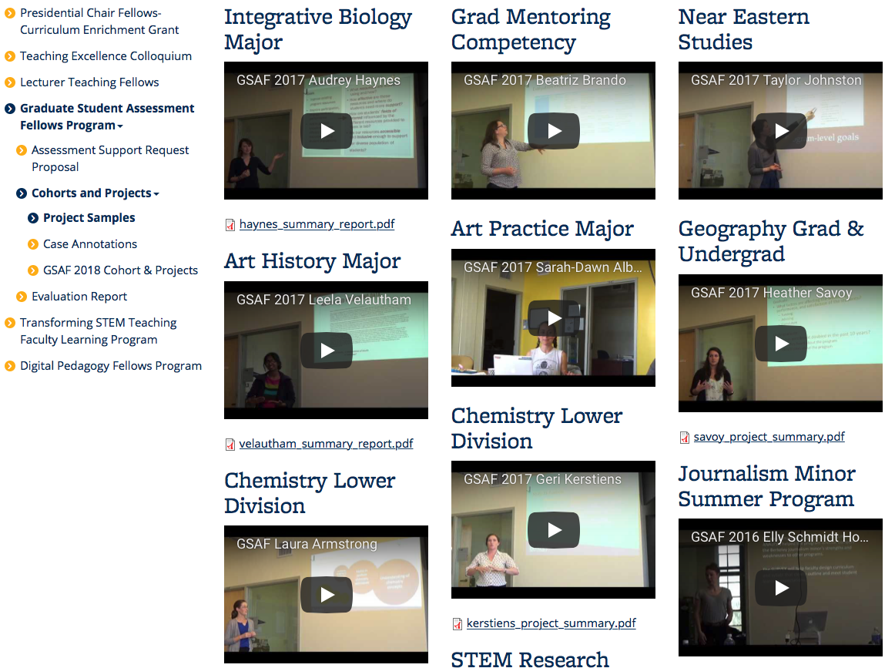
Assessment Work Samples
What are (universal) learning outcomes for the master’s program? How are courses related?
Inform course-level outcomes
Syllabi analysis
Faculty interviews
How can we restructure the Field Studies requirement (seminar + field experience) to best meet the desired learning outcomes?
→ Consensus on learning outcomes; New capstone paper requirement
Faculty interviews
Peer program practice gathering
Student focus groups
Are students graduating with intended program-level learning outcomes?
Inform junior & senior seminars
45-min case study analysis + writing session
Senior student focus group (post-writing)

Slide 35
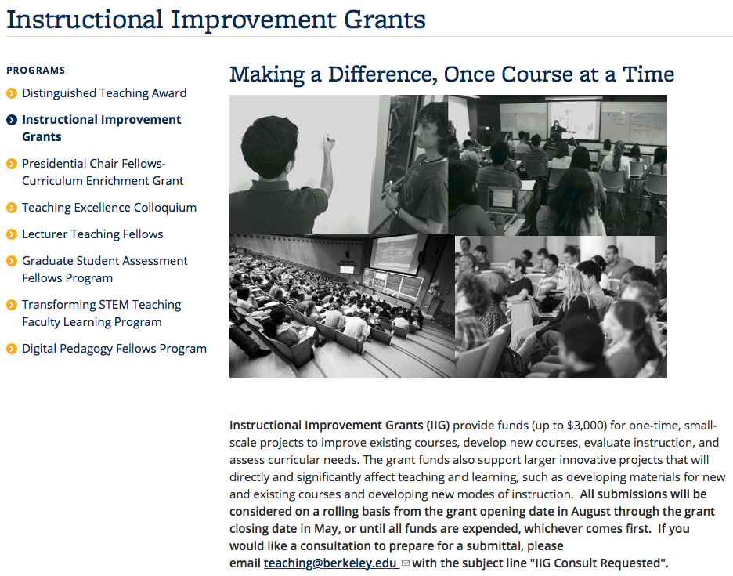
Up to $3000
Supports course improvement as well as curriculum assessment
Call: Rolling basis (opening date: August/January)
Notes:
Clarify/revise program-level student learning goals by gathering input from faculty, students, and other key stakeholders.
Examine what are the common foundational knowledge and skills needed across curricular tracks to inform the revisions of the required core courses.
Understand how research skills are threaded across curriculum by analyzing syllabi and interviewing faculty and discuss what needs to be improved.
Understand the impact of a recent curricular change (e.g., a new requirement, a new pedagogical innovation made across courses) on student learning. Understand what was effective and what needs further adjustment.

Slide 36
Agenda
Time | Topic | Lead Presenter
9:15 a.m. | Overview of APR process | Tsu-Jae Liu
10:00 a.m. | Strategic planning | Katherine Mitchell
10:15 a.m. | Equity & inclusion planning | Amy Scharf
10:30 a.m. | Curriculum assessment | Yukiko Watanabe
10:45 a.m. | Additional Q&A

Slide 37
Additional Questions?

